Slide 1
Genomic Analysis Toolkit (GATK)
Does [0] compute?
Li Lei
Feb 7, 2017

Slide 2
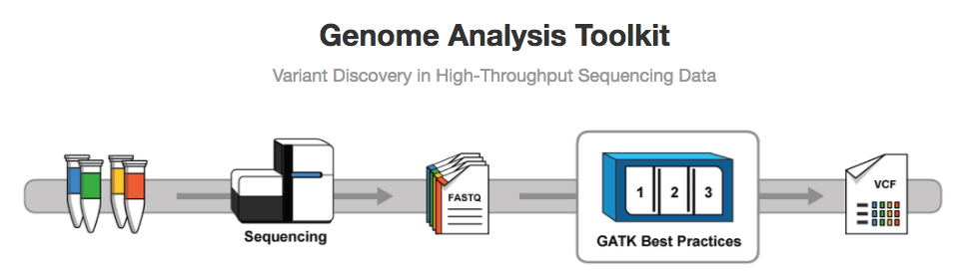
GATK
Download slides from: https://github.com/MorrellLAB/DoesNaughtCompute/tree/master/GATK_SNPs_calling

Slide 3
What is variants call?
A variant call is a conclusion that there is a nucleotide difference vs. some reference at a given position in an individual genome or transcriptome
Usually accompanied by an estimate of variant frequency and some measure of confidence.

Slide 4
Why need to call variants?

Slide 5
Why need to call variants?
DNA-seq: variants
Genetic associations with certain triats
Mutations in disease
Characterizing the features of populations, e.g., site frequency spectrum
RNA-seq:
Allele-specific expression
Allelic imbalance, often differential
Association with isoform usage (splicing QTLs)
RNA editing (allele absent from genome)
ChIP-seq: allele-specific binding

Slide 6
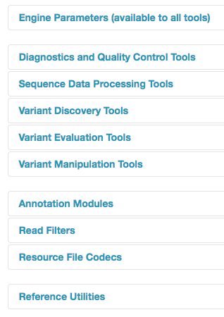
What can GATK do?
Notes:
1Downsampling coverage fraction interval intersection, 2 ASE counts 3 BaseRecalibrator indel realignment 4 haplotype caller , GenotypeGVCFs 5. Genotype concordance between two callsets

Slide 7
Best Practices workflow

Slide 8
sequence_handling handlers
Quality Assessment - FastQC (Oct 06th – Paul Hoffman)
Read depths - Zip/Unzip/Grep
Adapter trimming - Scythe (Oct 13th – Chaochih Liu)
Quality trimming - Sickle/ Seqqs (Oct 13th - Chaochih Liu)
Read mapping - BWA-MEM (Oct 20th/ 27th – P. Morrell/ Y. Zhang)
SAM processing - Picard/ SAMtools (Nov 10th /17th - L. Lei/ C. Pierce)
Coverage mapping - BEDtools
Indel realignment - GATK

Slide 18
https://software.broadinstitute.org/gatk/documentation/topic?name=methods

Slide 23
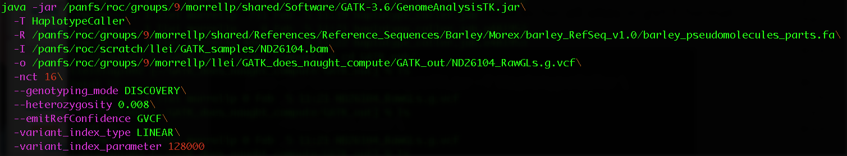
Example
Extension must be .vcf, or .g.vcf but NOT .gvcf

Slide 24
VCF vs. gVCF

Slide 27
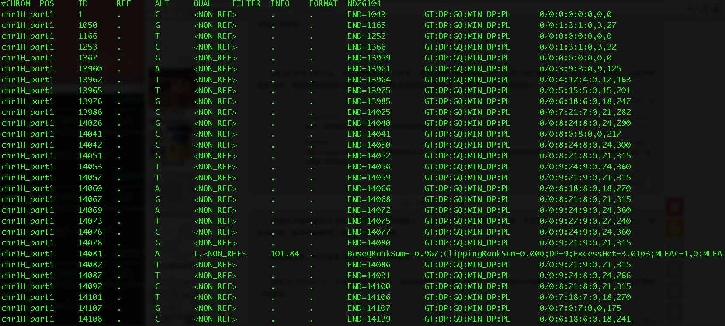

Slide 31
Coding challenge
#Call SNPs with GATK haplotypeCaller
git clone /panfs/roc/groups/9/morrellp/public/GATK_Example_Data
git clone https://github.com/MorrellLAB/DoesNaughtCompute.git
cd GATK_SNPs_calling
vi GATK_GenotypeGVCFs.job
# Then revise the script according to the comments and save the file
ssh lab
qsub GATK_GenotypeGVCFs.job
#GenotypeGVCFs:
#Then revise the script according to the comments and save the file
qsub haplotype_caller.job

Slide 32
Reference
https://drive.google.com/drive/folders/0BwTg3aXzGxEDVE10Z01yWHVtYlU

